Slide 1
Welcome to​ Star Light
A web-based rhythm game -

Slide 2
Table of contents
01
02
03
04
05
06
Introduction
System's Workflow
System Analysis and Design
Backend System Architecture
Demo
Conclusion

Slide 3
01
Introduction

Slide 4

Introduction
Main Idea: The "Star Light" web app is a rhythm-based game designed for an interactive music experience, combining gameplay mechanics, user customization, and performance tracking.
Key Features:
Gameplay: Players match rhythmic patterns to music tracks with adjustable key bindings.
Music Library: Access to a song library with varying difficulty levels.
Feedback: Beat count accuracy and score tracking for performance improvement.
Future Plans: Peer-to-peer multiplayer and community-created levels.
Development Approach:
Technologies: Uses modern frontend and backend tools with a robust database.
Scrum Methodology: Agile workflow focused on iterative user feedback.
Report Goal: To explain project objectives, features, technologies, and future developments.

Slide 5
02
System's Workflow

Slide 6
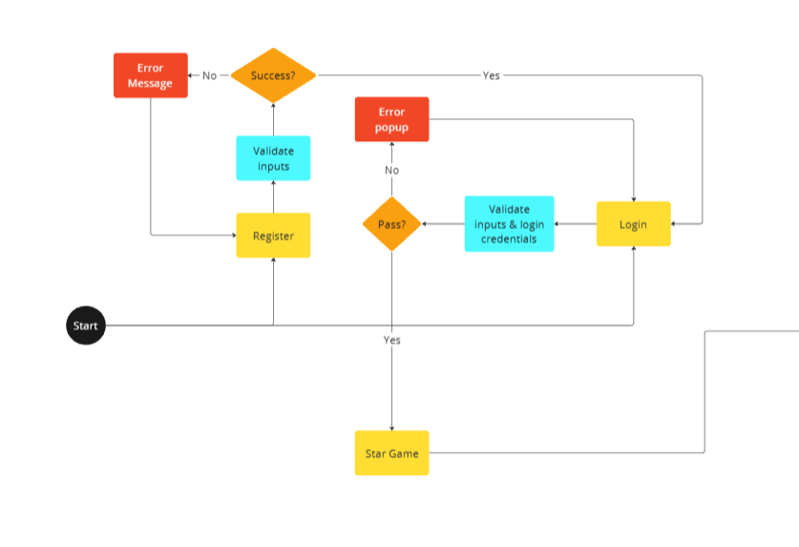
Landing Page
Purpose: Ensures secure user access to the game through authentication.
Users must log in or register to play.
Registration: Collects and validates email/password. Displays success on valid input.
Login: Validates credentials and redirects to Main Menu on success.
Forgot Password: Provide a alternative way to reset password by sending new pass code to login via email. User can change new password in Profile page.

Slide 7
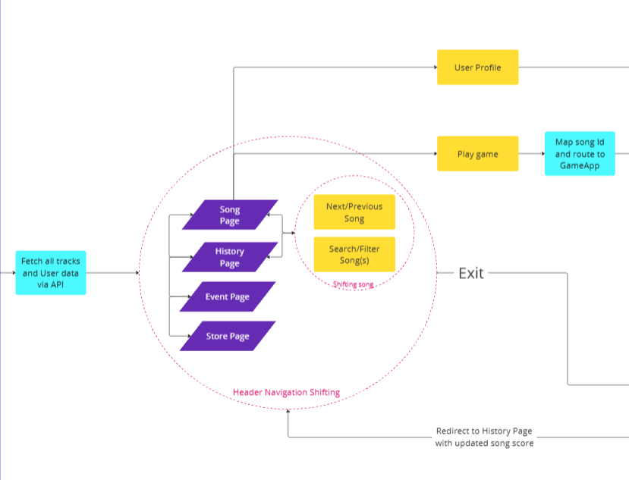
Main Menu Pages
Purpose: Hub for game navigation and data access.
Fetches song data and user details upon login.
Pages:
Song Page: Explore and play tracks.
History Page: Review past scores.
Event Page: View challenges. (Coming Soon)
Store Page: Purchase items. (Coming Soon)
Burger Menu: Search, filter, and select songs.

Slide 8
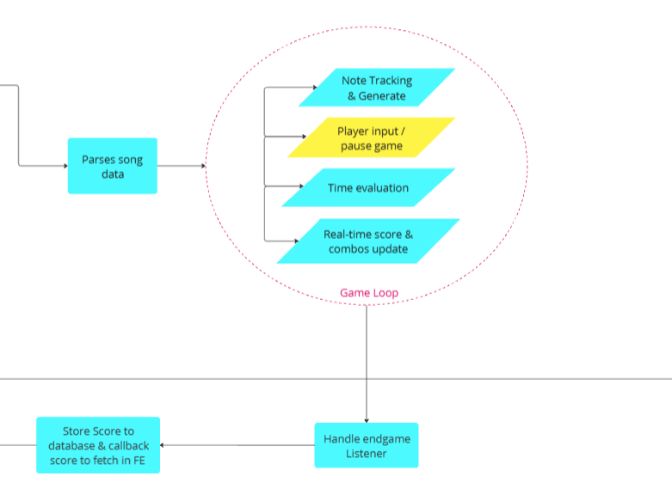
Gameplay Interface
Purpose: Core game mechanics for immersive play.
Prepares song data (beatmap, notes).
Game Loop: Syncs visual cues with rhythm, evaluates timing, and updates score live.
Post-Game: Saves performance metrics and redirects to History Page.

Slide 9
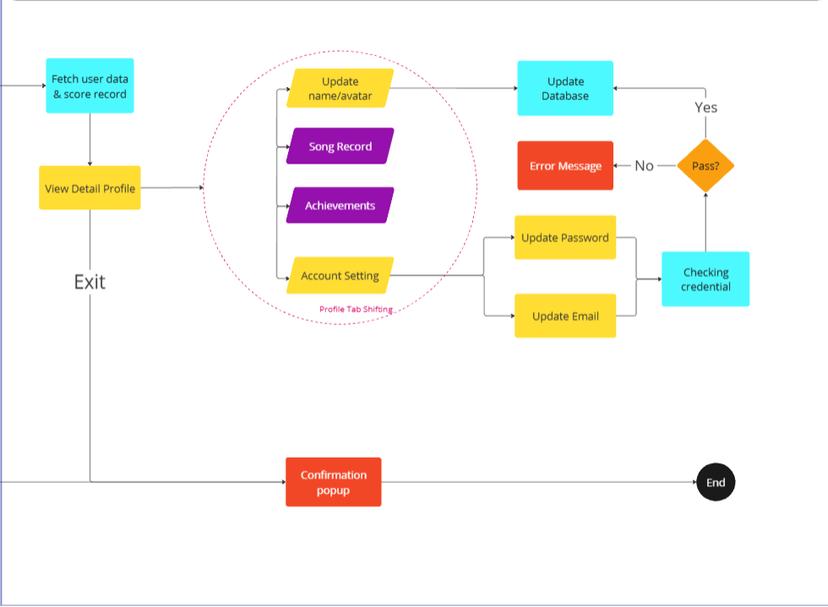
Profile Page
Purpose: Manage account and track progress.
Displays Song Records and Achievements.
Allows account updates with input validation.
Tabs for easy navigation (Records, Achievements, Settings).
Exit confirmed with a popup.

Slide 10
03
System Analysis & Design

Slide 11
Requirement Analysis
Functional Requirements
Non Functional Requirements
Authentication: Validate inputs; verify login credentials; reject invalid entries with error messages.
Data Storage: Save user info and gameplay scores tagged by user/song IDs.
APIs: Expose APIs for song tracks, user data, scores, and recent gameplay results.
Validation: Ensure data integrity for songs, users, and gameplay.
Navigation: Use React routing for seamless page transitions.
Search: Enable fuzzy song search with results displayed in the sidebar.
Gameplay: Process song data for dynamic sequences; evaluate performance in real-time.
Profile: Manage user data and stats; validate updates.
Error Handling: Provide error messages, log issues for debugging.
Usability: RESTful APIs with JSON responses.
Performance: APIs respond <200ms; real-time gameplay updates <50ms; 10 concurrent users supported.
Security: Encrypt sensitive data; use HTTPS and role-based authorization.
Dependability: Ensure 99.9% uptime; implement backups for recovery.
Monitoring: Log key events and monitor performance/resource usage.
Architecture: Modular and scalable for future extensions.
Testing: Comprehensive testing before deployment.
Best Practices: Maintain documentation and version control.

Slide 12
04
Backend System Architecture

Slide 13
Backend Architecture
Data Management
User Interaction and Entry point
Secured via HTTPS with NGINX as a reverse proxy.
Manages authentication (cookies) and authorization for sensitive actions.
AWS Lambda: Generates game levels on-demand.
MySQL: Stores user data, scores, and asset paths efficiently.
Backend Core Logic
Routes requests, enables CORS, and supports CRUD operations for user assets.
External Integrations
Scalability and Security
Twilio SendGrid: Handles email notifications and verifications.
Full HTTPS encryption and scalable AWS infrastructure.

Slide 14
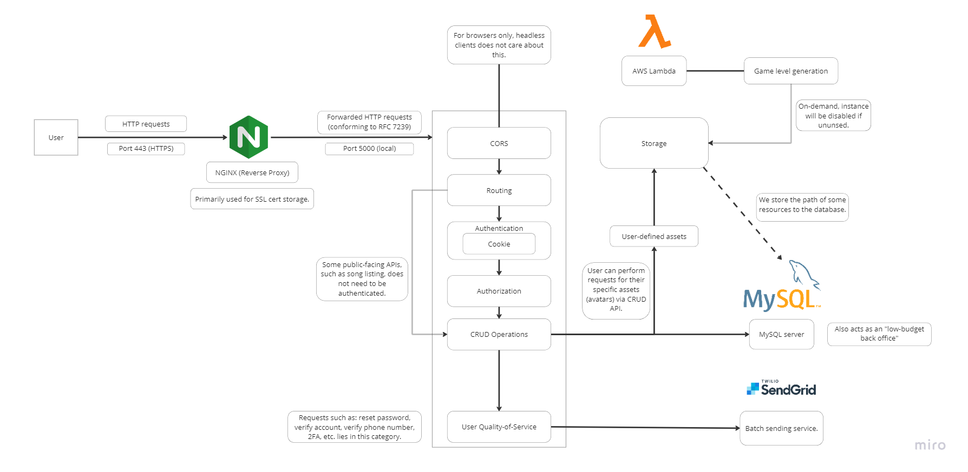
Backend Architecture

Slide 15
05
Demo

Slide 16
06
Conclusion

Slide 17


Conclusion
"Star Light" is a dynamic web-based rhythm game with engaging features and room for expansion. Future updates aim to enhance gameplay, community interaction, and user customization.

Slide 18
Thanks
Do you have any questions?

